Slide 1
Project Risk Management: An Overview
Andrew Westdorp
Program Manger, IV&V
Lockheed Martin
(301)402-3924
Westdorpa@mail.nih.gov
Notes:
Introduce Myself and the topic to be presented

Slide 2
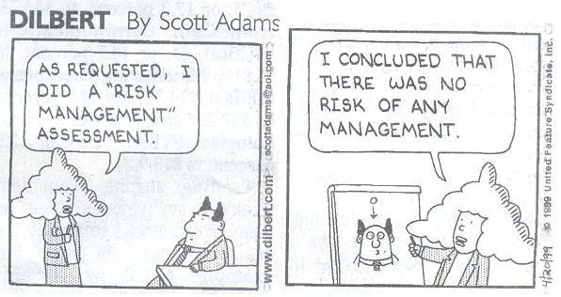
Dilbert’s Take…
Notes:
This is funny, but it does tell us one major thing about Risk Management…Your agency or business must practice Project Management, or what I will be going over today will on no use…

Slide 3
Goals and Objectives
Project Risk
Risk Management
Why Risk Management
Risk Management Planning
Identifying & Quantifying Risks
Response Planning
Risk Monitoring & Control
Tools, Tricks and Helpful Links
Notes:
Goals & Objectives:
Project Risk – What is it, and how do you known when you have found it
Risk Mgmt – PMBOK Definition, and steps to the entire management process
Risk Mgmt Planning – Discuss “planning for the plan”, appropriateness (6 questions to ask yourself before planning.)
Identify – What is a risk and how do you identify it
Qualify – Create a prioritized list based on gut/history
Quantify – Top risks should be quantified for probability and impact (examples)
Response Planning – What are we going to do if? Who is going to be responsible? The Risk Register!
Risk Monitoring & Control – Keeping and eye open and following your plan.
Tools… - Give you some ideas of where to go, how to do this, and what some examples look like.
What you don’t want – Dilbert cartoon - no

Slide 4

What is Project Risk?
An event that, if it occurs, causes either a positive or negative impact on a project
Keys attributes of Risk
  Uncertainty
  Positive and Negative
  Cause and Consequence
Notes:
CAN NOT be done until a WBS has been developed…you must know WHAT the project is and is not.
It is not just the BIG stuff…the little things can hurt the most
KEYS:
Uncertainty – It could happen, and well it might not, too.
Focus for this presentation is on Negative, but there are positive risks (AKA – opportunities)
All risks have a cause and a consequence. Your job through this process is to identify these.
Known – identified and addressed…Unknown – those risks you cannot identify or know about and cannot be managed (budget for them only)
Risk overall guide project success…a company/agency may be more or less risk averse which will determine how they view risks and the responses required for them. Some risk can be good if the reward is offsetting the risk.

Slide 5
Risk Management
Risk management is concerned with identifying risks and drawing up plans to minimise their effect on a project.
A risk is a probability that some adverse (or positive) circumstance will occur
  Project risks affect schedule or resources;
  Product risks affect the quality or performance of the software being developed;
  Business risks affect the organization developing or procuring the software.

Slide 6
Risk Management Process
PMBOK ® Definition
  “The systematic process of identifying, analyzing, and responding to project risk”
Steps
  Risk Management Planning
  Risk Identification
  Qualitative/Quantitative Risk Analysis
  Risk Response Planning
  Risk Monitoring & Control
Notes:
Risk management is a process
It is iterative, continuous and can be done in many different ways
This is PMI’s approach that can be tailored to your specific agency/business
Identify….Analyze….Respond

Slide 7
Value From Managing Risks
Opportunity to move from “fire-fighting” to proactive decision making on the project.
Better chance of project success.
Improved project schedule and cost performance.
Stakeholders and team members better understand the nature of the project.
Helps define the strengths and weaknesses of the project.

Slide 8
Why Not Risk Management?
With so much benefit to managing risk, why is it often overlooked? :
  The organization is too busy with real problems to worry about potential ones,
  There is a perception that there is not too much that can go wrong, or
  They have a fatalistic belief that not much can be done about risks, or
  “Shoot the messenger mentality”; fear that disclosure of project risks will be seen as an indication of project weakness.

Slide 9
Won’t identified risks make the project look bad?
All projects have risks, denial does not make them go away, it just makes you unprepared for them if they occur.
Risk in itself is not bad, it is how well the project plans for and reacts to risks that counts.
Formal risk management is a cornerstone of good project management. Stakeholder visibility into project risks makes it easier to get additional resources and organizational support when risks do occur.

Slide 10
Risk Management Planning
Plan for the Planning
  Risk planning should be appropriate for the project
  Question you should ask:
    How risky is the project?
    Is it a new technology or something your organization is familiar with?
    Do you have past projects to reference?
    What is the visibility of the project?
    How big is the project?
    How important is the project?
Notes:
Plan for the Planning
How will we approach risk management for this project?
Goal/Output: Risk Management Plan
Make sure you are not OVER Planning

Slide 11

The Risk Management Plan
What should it include?
  How you will identify, quantify or qualify risk
    Methods and tools
  Budget…yes budget
  Who is doing what
  How often
  Risk categories, levels, and thresholds for action.
  Reporting requirements
  Monitoring, tracking and documenting strategies
Notes:
Talking Points:
Budget – should include contingency funding for unknown risks, also should include the cost of the process itself (people’s time and efforts to identify, monitor and control)
WHO… - Every risk “above the line” should have a sponsor or watcher responsible for it.
WHEN… - Establishes the risk tolerance threshold for the project
Reports – Who, when, how often, what, etc.
Monitoring… - Again…WHO, HOW, HOW OFTEN, etc. It is iterative. Also, record keeping is essential to assist in future projects

Slide 12
The Risk Management Process
Risk identification
  Identify project, product and business risks;
Risk analysis
  Assess the likelihood and consequences of these risks;
Risk response planning
  Draw up plans to avoid or minimize the effects of the risk;
Risk monitoring
  Monitor the risks throughout the project;

Slide 13
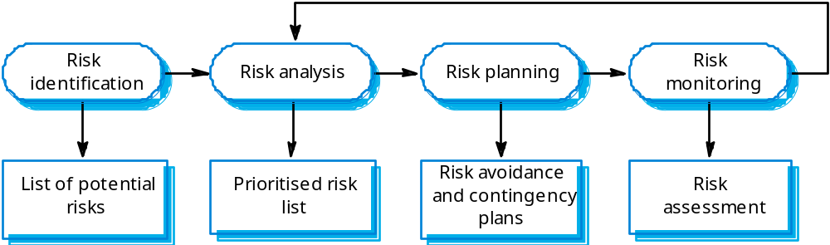
The Risk Management Process

Slide 14

Identifying Risk
Continuous, Iterative Process
What is it and what does it look like
The sooner the better
The more the merrier
A fact is not a risk (it’s an issue).
Be specific
Don’t try to do everything at once
Notes:
What – Can’t tell you…Different for each project and person consulted. In the end it is a long list.
Sooner – Needs to be done as soon as a project is identified, and in some cases before the project is even approved
More – The more heads you involve (stakeholders) the better the process outcome will be
Fact – That which is a known is by definition not an uncertainty. If you know something is going to occur then you plan for it not the risk of it.
Specific – You should be able to identify the risk and a trigger/cause of the risk. Example: The hardware may arrive late (TRIGGER) causing a delay in the schedule (RISK).
Should be able to answer – WHAT & WHY
Don’t… - Don’t try to qualify, quantify, or remedy at this point…that is coming.

Slide 15
Identification Techniques
Brainstorming
Checklists
Interviewing
SWOT Analysis (strengths, weaknesses opportunities, threats)
Delphi Technique (anonymous consensus building)
Diagramming Techniques
  Cause & effect
  Flow Charts
  Influence Diagrams
Notes:
Checklists – Lists developed to aid in identifying risks. Will show examples at end.
SWOT – A process whereby you actually identify the Strengths, Weaknesses, Opportunities and Threats to the project, thus identifying your risks along the way.
Delphi – Expert Questionnaire approach. Each person answers independently of the other. Takes several iterations to get to the final lists.
Diagramming – Never used or rarely used, but can be useful (Flow charts is most useful). See websites at end for more information.

Slide 16
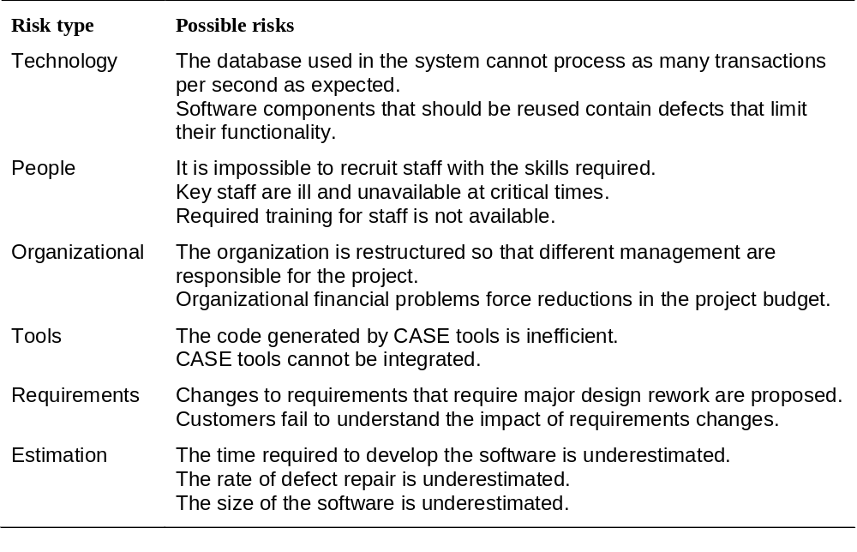
Risks and Risk Types

Slide 17
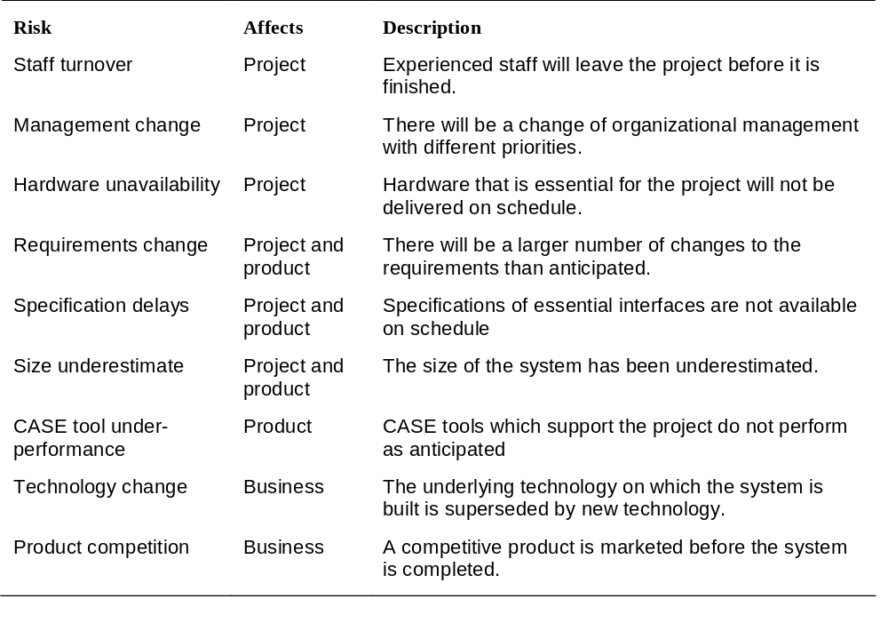
Software Risks

Slide 18
Risk Analysis
Assess probability, seriousness, and urgency of each risk.
Probability may be very low, low, moderate, high or very high.
Risk effects might be catastrophic, serious, tolerable or insignificant.
Urgency might be immediate, short term, or long term.

Slide 19

Analyzing Risk - Qualitative
Subjective
Educated Guess
High, Medium, Low
Red, Yellow, Green
1-10
Prioritized/Ranked list of ALL identified risks
First step in risk analysis!

Slide 20
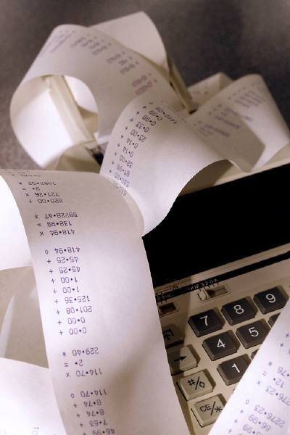
Risk Analysis - Quantitative
Numerical/Statistical Analysis
Determines probability of occurrence and consequences of risks
Should be focused to highest risks as determined by Qualitative Risk Analysis and Risk Threshold

Slide 21
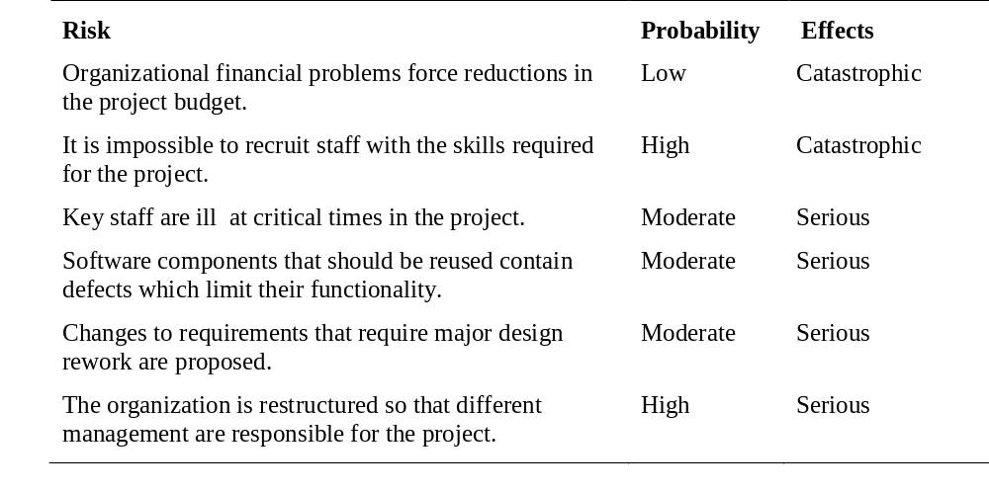
Risk Analysis (i)

Slide 22
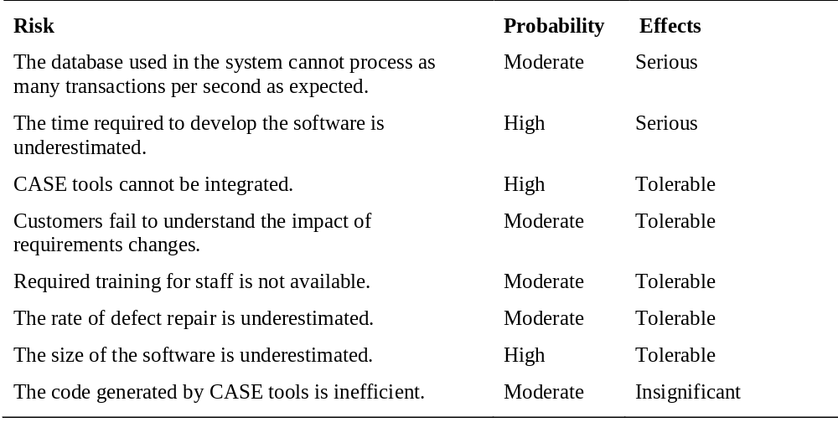
Risk Analysis (ii)

Slide 23
Probability & Impact Analysis
Risk | Probability | Impact | Expected Value
1 | 25% | $45,000 | $11,250
2 | 50% | $2,000 | $1,000
3 | 30% | $100,000 | $30,000
Notes:
Also referred to as Expected Value Analysis.
In this example we can see that by focusing on the wrong risk, you could easily have cost your project budget.
The biggest risk isn’t always the biggest risk!

Slide 24
Risk Response Planning
“What are we going to do about it?”
Techniques/Strategies:
  Avoidance – Eliminate it
  Transference – Pawn it off
  Mitigation – Reduce probability or impact of it
  Acceptance – Do nothing
Strategy should be commensurate with risk
  Hint: Don’t spend more money preventing the risk than the impact of the risk would be if it occurs ☺
The Risk Response Plan/Risk Response Register
Notes:
Avoidance – can we change the plan to avoid the risk.
Transference – Transfer the risk or responsibility of the risk to a third party. Insurance, performance bonds, warranties, guarantees.
Mitigation – Usually involves increased costs/budget, but overall the goal is to try and lessen the risk to an acceptable level.
Examples:
Conducting more tests (reduces the problem)
Choosing a more established vendor (reduces the problem)
Adding resources or time to project (reduces impact)
Designing redundancy into a system (reduces impact)
Acceptance – Active – Good (contingency Planning…IF, THEN), Passive – Bad (PUT OUT THE FIRES)

Slide 25
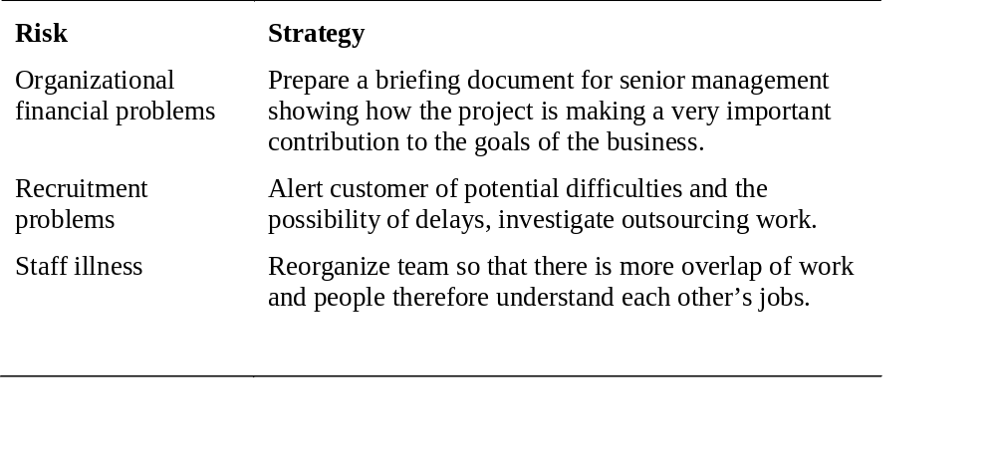
Risk Management Strategies (i)

Slide 26
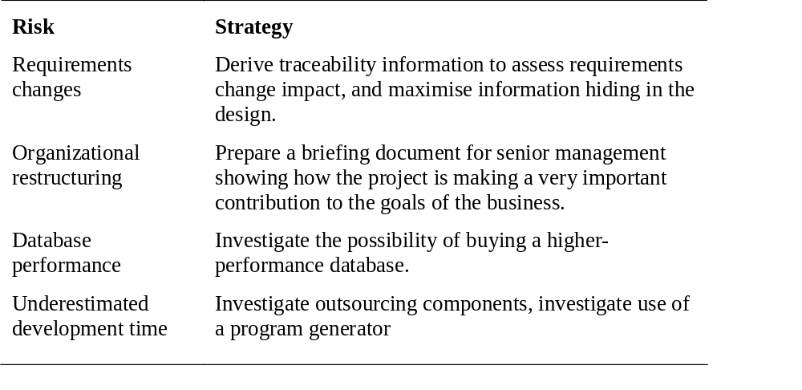
Risk Management Strategies (ii)

Slide 27
Risk Monitoring
Assess each identified risk regularly to decide whether or not it is becoming less or more probable.
Also assess whether the effects of the risk have changed.
Each key risk should be discussed at management progress meetings.

Slide 28
Risk Monitoring & Control
Continuous, Iterative Process
Done right the risk impact will be minimized:
  Someone IS responsible
  Watch for risk triggers
  Communicate…Communicate…Communicate
  Take corrective action - Execute
  Re-evaluate and look for new risk constantly
Tools:
  Risk Reviews
  Risk Audits
Notes:
Risk reviews – regular meeting where the risk team evaluates the risk register for any necessary additions, deletions, or changes to prioritization due to probability or impact changes.
Risk Audits – review by outside person of risk response plan and how it is being implemented. Good for future use on projects.

Slide 29
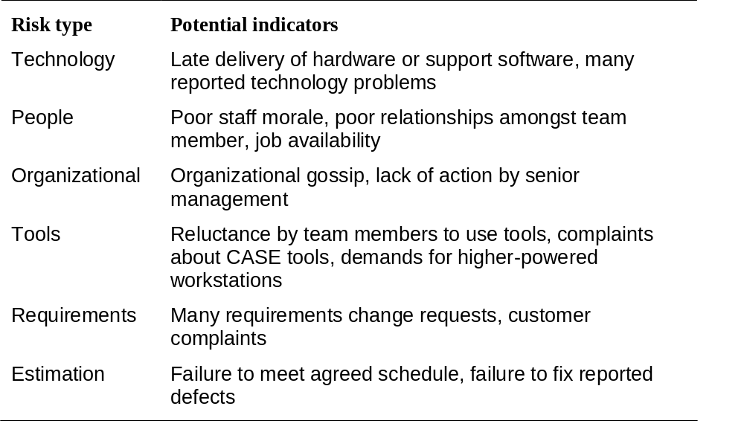
Risk indicators

Slide 30
Tools & Tricks
Risk Identification Spreadsheet
Risk log Spreadsheet
Templates
Make your own

Slide 31
Helpful Links
Project Management Institute (PMI)
  www.pmi.org
CMMI
  www.sei.cmu.edu/cmmi/
PMI Government SIG
  www.pmi-govsig.org
NIH Project Management Center of Excellence
  http://irm.cit.nih.gov/cio/PMExcellence/

Slide 32
Questions???
Thank You
for the opportunity
to present to you today!

